Slide 1

The Corporation and Its Stakeholders
Chapter 1
Copyright ©2020 McGraw-Hill Education. All rights reserved. Authorized only for instructor use in the classroom. No reproduction or distribution without the prior written consent of McGraw-Hill Education.

Slide 2

Business and society together form an interactive social system1
Business: organizations engaged in making a product or providing a service for profit.
Society: Human beings and the social structures they collectively create.

Slide 3
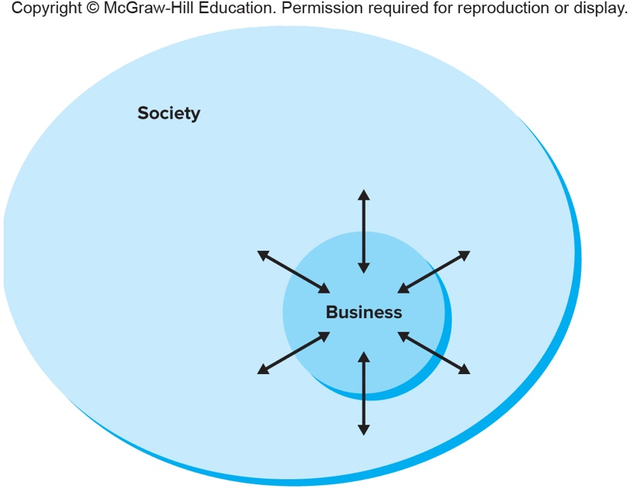
Business and society together form an interactive social system2
Figure 1.1
Copyright © McGraw-Hill Education. Permission required for reproduction or display.
Business and Society: An Interactive System
Access the text alternative for these images.

Slide 4

Business and society together form an interactive social system3
General Systems Theory (GST):
  Organisms do not exist in isolation but can only be understood in relationship to their surroundings.
  Businesses are embedded in a broader social environment with which they constantly interact.

Slide 5

Purpose of Business
What is the purpose of the corporation?
To whom, or what, should the firm be responsible?

Slide 6

Shareholder Theory of the Firm1
  Sees the firm as property of owners (shareholders).
  Owners’ interests take precedence over interests of others.
  The purpose of the firm is to maximize its long-term market value and money for its shareholders.

Slide 7

Stakeholder Theory of the Firm2
Corporations serve a broad public purpose: to create value for society.
Profit is necessary for survival, but is not the only purpose of the firm.
Corporations have multiple obligations and need to consider all stakeholders.

Slide 8
Shareholder theory and stakeholder theory define the purpose of business differently
Shareholder
Purpose
Owners’Needs and Wants
Share Value
Stakeholder
Purpose
Stakeholders’ Needs and Wants

Slide 9
Three arguments in support of the stakeholder theory of the firm
Stakeholder management is the right thing to do
Descriptive
Normative
Instrumental
realistic description of how companies really work
stakeholder consideration key for effective corporate strategy

Slide 10

Stakeholders
Stakeholders are persons or groups that affect, or are affected by, a firm’s decisions, policies, and operations.
A stake is an interest in–or claim on–a business.
Stakeholder is NOT the same as stockholder (or shareholder).
Shareholders are just one of several kinds of stakeholders.

Slide 11
Internal stakeholders are employed by the firm - external stakeholders are not
Employees
Suppliers
Society
Government
Company
Creditors
Managers
Shareholders
Customers
Internal stakeholders
work “inside” the firm and contribute their effort and skill to everyday operations.
External stakeholders
may have important transactions with the firm, but are not on its payroll.

Slide 12
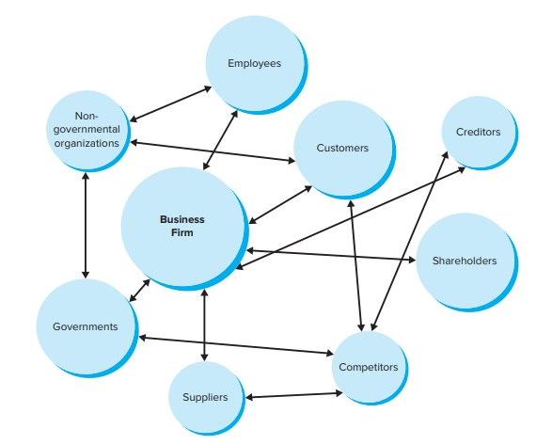
A Firm and Its Stakeholders
Figure 1.2
Copyright © McGraw-Hill Education. Permission required for reproduction or display.
Access the text alternative for these images.

Slide 13



Two Kinds of Stakeholders: Market and Nonmarket
Market stakeholders
Shareholders, suppliers, employees, etc.
They engage in economic transactions with the company as it carries out its primary purpose of providing society with goods and services.
Nonmarket stakeholders
Community, government, business support groups, etc.
People or groups who—although they do not engage in direct economic exchange with the firm—are affected by or can affect its actions.
Government
Stakeholder analysis includes the identification of relevant stakeholders and an analysis of their interests and power.
Environment
Notes:
Stakeholders analysis:
Who are the relevant stakeholders?
What are the interests of each stakeholder?
What is the power of each stakeholder?
How are coalitions likely to form?

Slide 14

Stakeholder Analysis Questions
Q1. Who are the relevant stakeholders?
Q2. What are the interests of each stakeholder?
Notes:
Q1. Draw market and nonmarket stakeholder maps.
Recognize not all groups are relevant to every situation.
→ Examples:
Some businesses sell directly to the public and will not have retailers.
A certain stakeholder may not be relevant to a particular decision/action
Q2.
What are the groups’ concerns?
What does the group want/expect from their relationship with the firm?
→ Examples:
Shareholders have an ownership interest; they expect to receive dividends and capital appreciation.
Customers are interested in gaining fair value and quality in goods and services they purchase.
Public interest groups advance broad social interests.

Slide 15

Stakeholder Analysis Questions
Q3. What is the power of each stakeholder?
Q4. How are stakeholder coalitions likely to form?
Notes:
Q3. Stakeholder power is the ability of a group to use resources to make an event happen or to secure a desired outcome.
There are 5 types of stakeholder power:
Voting Power
The legal right to cast a shareholder vote.
Economic Power
The ability to grant or withhold transactions with the focal company.
Political Power
Actions taken through legislation, regulations, or lawsuits.
Legal Power
Lawsuits filed against the focal company for harm caused by the firm.
Informational Power
Having access to valuable data, facts, or details.
Q4.
Stakeholder groups often have common interests and will form temporary alliances to pursue these common interests.
Coalitions are very dynamic (can change at any time).
Coalitions are increasingly international.
Internet has enabled coalitions to form quickly, across political boundaries.

Slide 16
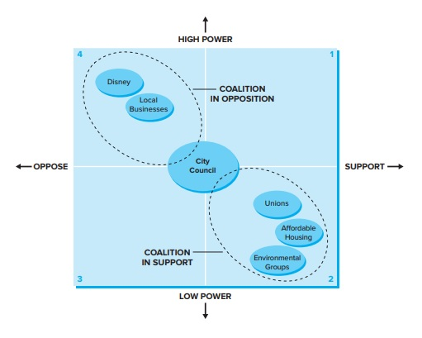
Stakeholder Mapping
Stakeholder map – a visual representation of the relationships among stakeholder interests, power, and coalitions with respect to a particular issue.
Notes:
A stakeholder map is a useful tool, because it enables managers to quickly see how stakeholders feel about an issue, how coalitions are likely to form, how powerful these coalitions are, and what outcomes are likely.

Slide 17
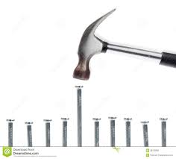
Stakeholder Salience
Salient – stands out from a background, is seen as important, or draws attention.
Stakeholders stand out (i.e., are salient) to managers when they have power, legitimacy, and urgency.

Slide 18

The Corporation’s
Boundary-Spanning Departments1
Boundary-spanning departments (shown graphically in the following slide): departments or offices within an organization that reach across the dividing line that separates the company from groups and people in society.
Building positive and mutually beneficial relationships across organizational boundaries is a growing part of management’s role.

Slide 19
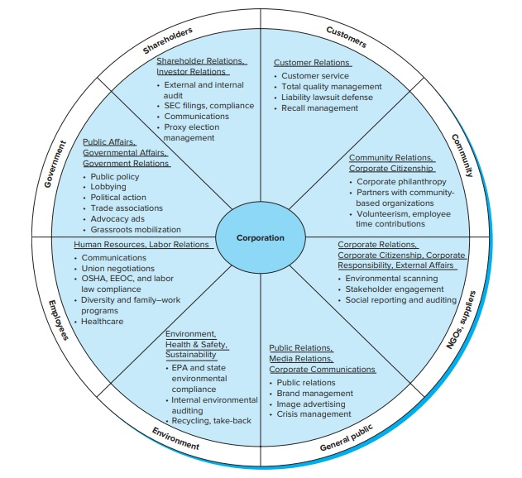
The Corporation’s
Boundary Spanning Departments2
Figure 1.5
Copyright © McGraw-Hill Education. Permission required for reproduction or display.
Access the text alternative for these images.

Slide 20
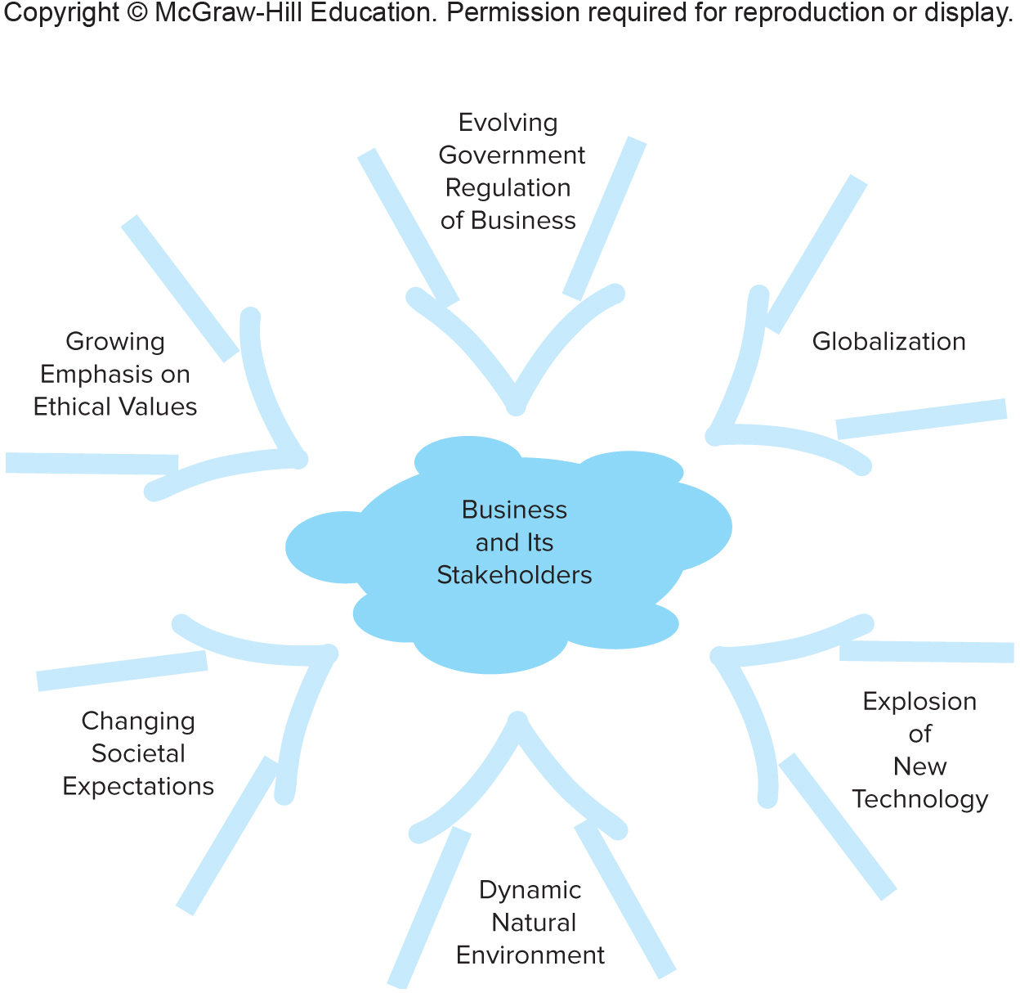
Forces That Shape The Business
And Society Relationship
Figure 1.6
Copyright © McGraw-Hill Education. Permission required for reproduction or display.
Access the text alternative for these images.
Notes:
The purpose of the firm is not simply to make a profit, but to create value for all its stakeholders – a successful business must meet both its economic and social objectives.
Six dynamic forces powerfully shape the business and society relationship:
Changing societal expectations.
Growing emphasis on ethical reasoning and actions.
Globalization.
Evolving government regulations and business response.
Dynamic natural environment.
Explosion of new technology and innovation.

